Slide 6
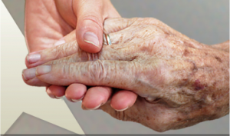
The 7 Habits of Happy People

Slide 7
Relationships
People who have one or more close friendships appear to be happier.
The sharing of personal feelings (self-disclosure) plays a major role in the relief of stress and depression.
Listening carefully and responding in encouraging ways (Active-Constructive Responding) is a very effective way to cultivate positive emotions and deepen relationships.

Slide 8
Acts of Kindness
People who care for others’ well-being through acts of altruism, volunteering, or formation of communal relationships seem to be happier and less depressed.
This seems to be especially true in older individuals.

Slide 9
Exercise and physical wellbeing
Abundant scientific research demonstrates the close connection of the mind and body.
Positive lifestyle factors including exercise, nutrition, sunlight, and sleep are associated with improved mental well-being and lower incidence of depression and anxiety.

Slide 10
Flow
If we are actively involved in trying to reach a goal, or an activity that is challenging but well suited to our skills, we experience a joyful state called “flow.”
The experience of flow in both professional and leisure activities leads to increased positive affect, performance, and commitment to long-term, meaningful goals.

Slide 11
Spiritual engagement and meaning
People follow spiritual paths and join religious organizations for a variety of reasons, including faith, prayer, social support, community service, cultural tradition, friendship, commitment to the community and more.
Studies demonstrate a close link between religious and spiritual engagement (practice) and happiness.

Slide 12
Strengths and Virtues
The work of positive psychologists like Martin Seligman appears to show that the happiest people are those that have discovered their unique strengths (such as persistence and critical thinking) and virtues (such as humanity or justice) and use those strengths and virtues for a purpose that is greater than their own personal goals.

Slide 13
Positive Mindset: Optimism, Mindfulness &Gratitude Optimism has been proven to improve the immune system, prevent chronic disease, and help people cope with unfortunate news. Gratitude is associated with optimism and has been determined that grateful people are happier, receive more social support, are less stressed, and are less depressed. Recent research indicates that optimists and pessimists approach problems differently, and their ability to cope successfully with adversity differs as a result.

Slide 14
WHEN IT COMES TO THOUGHTS, YOU HAVE A LOT OF MIND CONTROL!! YOUR BODY LISTENS
AND RESPONDS TO YOUR THOUGHTS!!!!
Your mental self-talk can be:
P O S I T I V E or N E G A T I V E
2 examples:
1. In Sports Psychology an athlete is taught to stay positive,
to stay calm, be focused, be confident, to “see yourself as a
winner,” and to “picture the ball going in the hole.”
Many athletes find success with this positive thinking and imagery.
2. In relaxation therapy you imagine a place or event that is
peaceful, restful, beautiful and happy. The body actually responds
with lower blood pressure, lower pulse rate to calm down and relax.

Slide 15
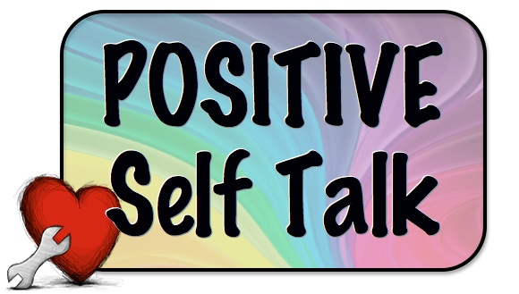
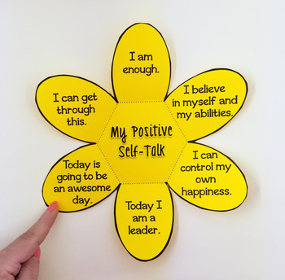
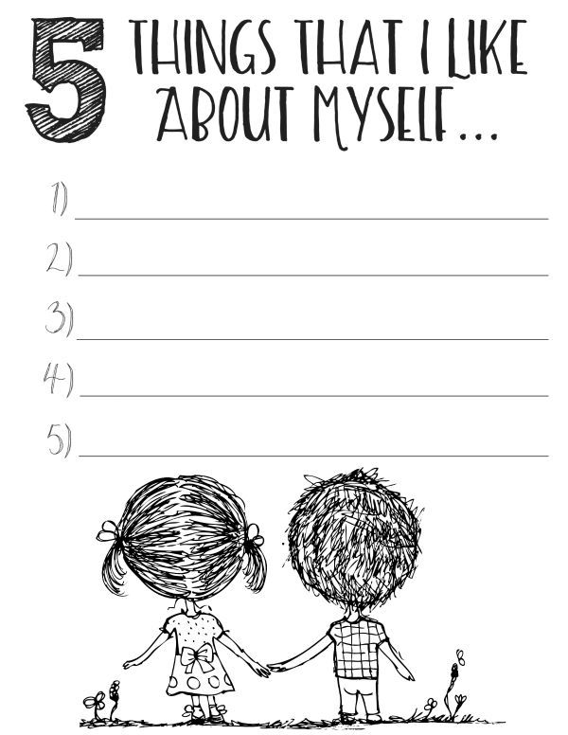

Slide 17
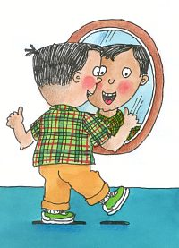
The #1 best way to improve self-esteem
and stay strong against “mean” people
is:
positive self-talk :)

Slide 18
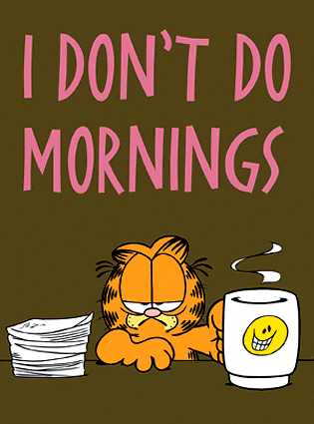
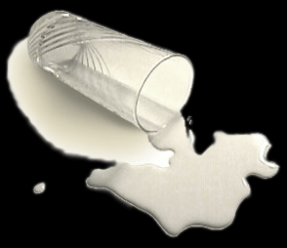
Whatever you tell yourself, your subconscious brain will
believe as truth and it will work to make that true for you !!!
For instance, if you say you aren’t a morning person your subconscious brain will reinforce that idea! You may feel tired, hit the “snooze bar” and spill things, etc.

Slide 19
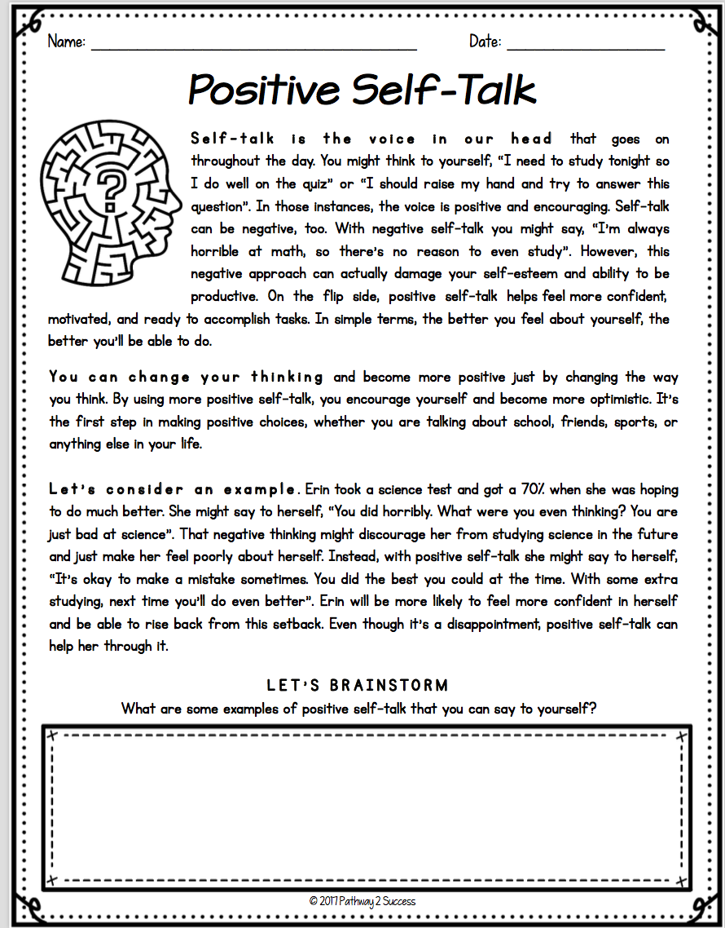

Slide 20
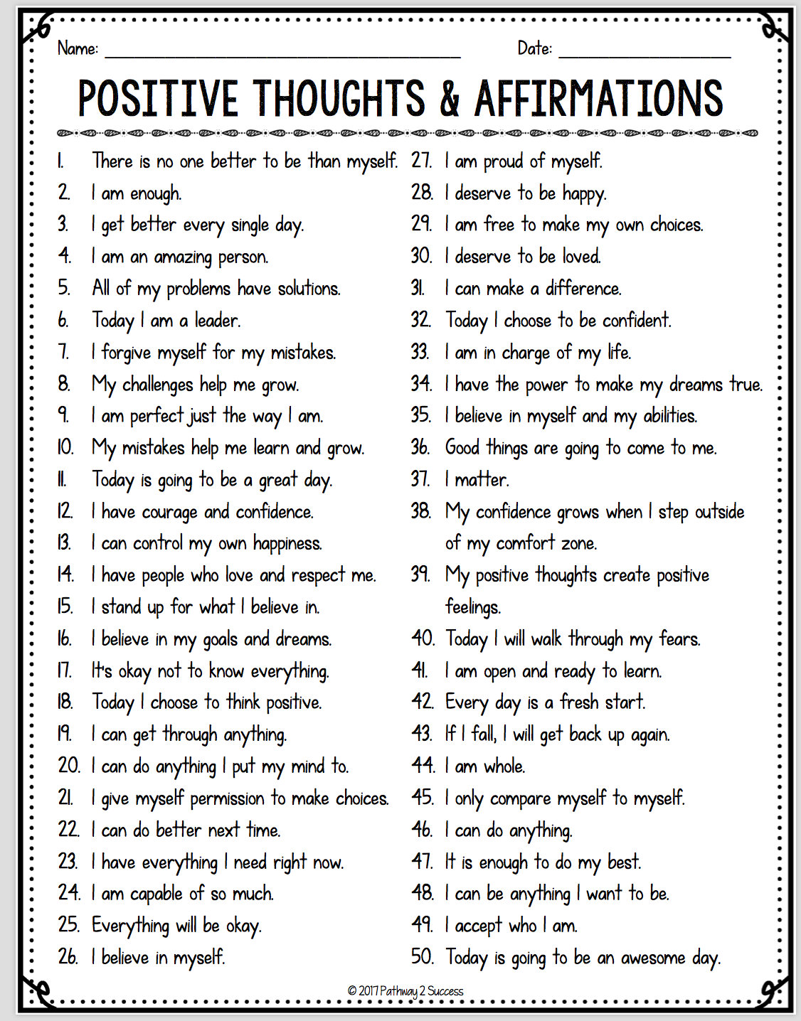
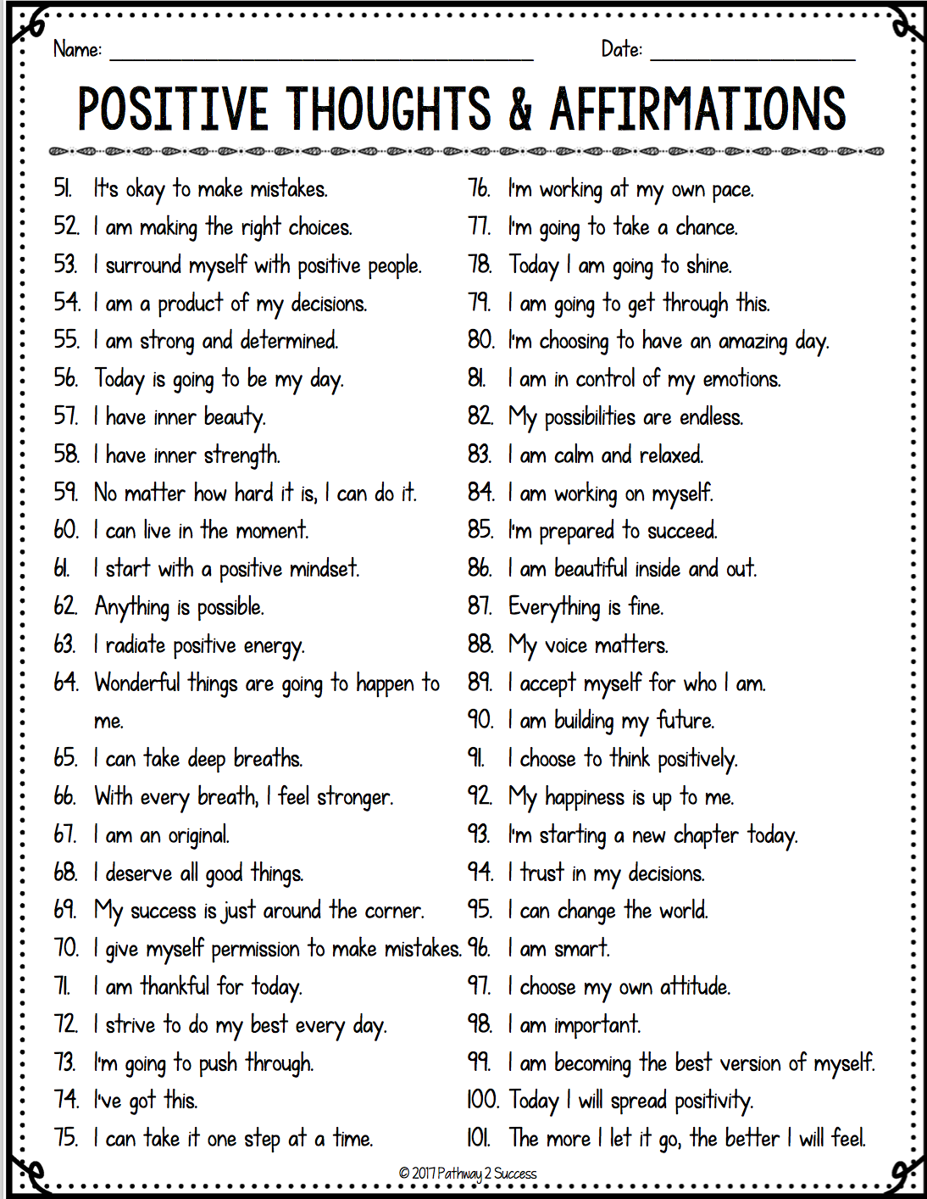

Slide 21
